Slide 1
Long reads: mapping to genome assembly
Arang Rhie
Adam Phillippy’s Group
Genome Informatics Section, NHGRI
July 18. 2019.

Slide 2
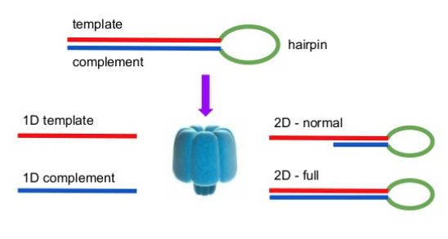
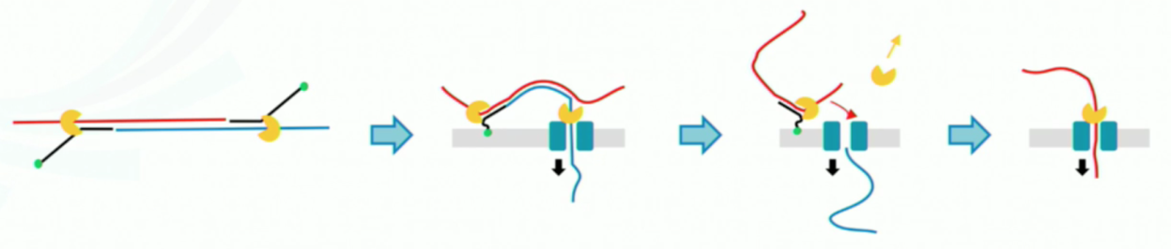

Long reads
(Hi-Fi)
1D²

Slide 3

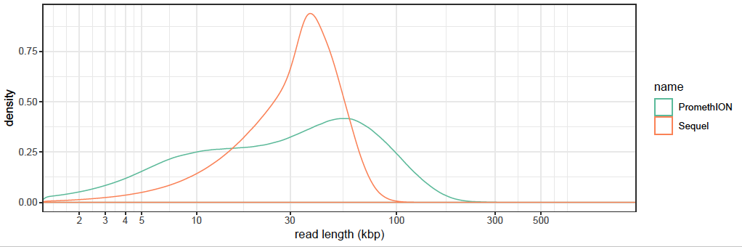
How long are they?
70x Nanopore 1D reads
88x Pacbio subreads
Fraction of bases in reads of length X

Slide 4
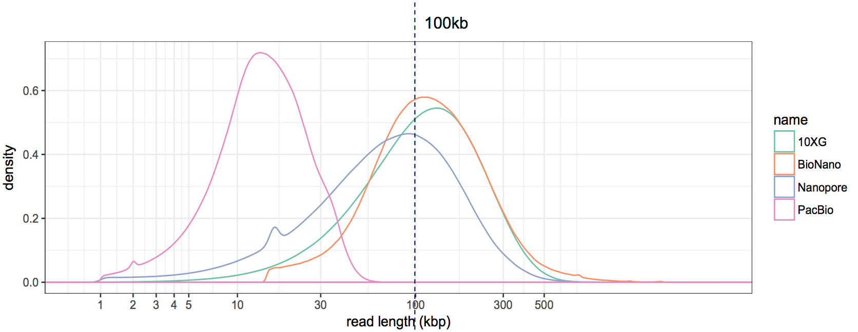
Another data from CHM13
30x Nanopore ultra long reads
60x Pacbio subreads
github.com/nanopore-wgs-consortium/chm13
4

Slide 5
Read identity
Improved single-pass
Raw median error 7.3%
vs 11.04% before
vs 12.2% PacBio V3
Reduce systematic bias
Corrected median error 1.5%
vs 5% before
vs 1.2% PacBio V2
Median BAC accuracy
Q21 asm
vs Q20 PacBio + OxNan before
Q30 post-polishing
vs Q23 before
vs Q40 PacBio
Density (%)
Read identity
to the best assembly of the same individual
(weighted by alignment length)
5

Slide 6
Read length vs. accuracy
illumina PE
QV
PacBio CCS (Hi-Fi)
PacBio Subreads
Nanopore 1D
Nanopore Ultralong reads
Read length

Slide 7
Mapping to a reference

Slide 8
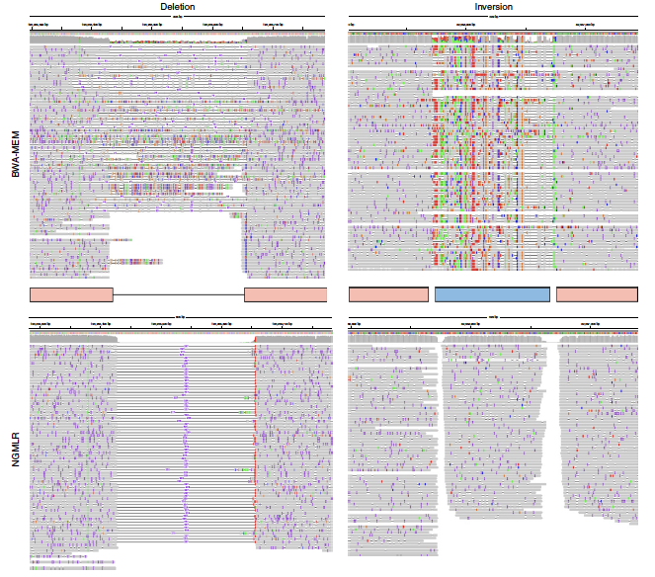
Deletion
Sedlazeck et al., Accurate detection of complex structural variations using single-molecule sequencing. Nat Methods (2018)

Slide 9
Inversion
NGMLR
BWA-MEM
Sedlazeck et al., Accurate detection of complex structural variations using single-molecule sequencing. Nat Methods (2018)

Slide 10
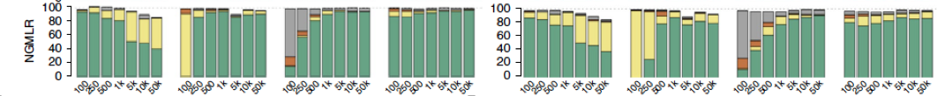
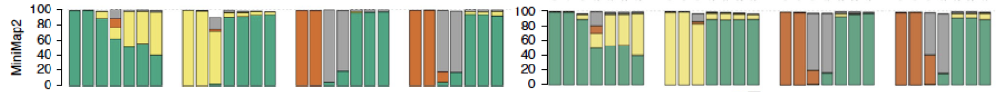
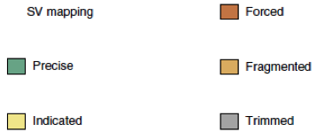
Mapping through SVs
PacBio
Nanopore
Indel
Dup
Transloc
Inv
Indel
Dup
Transloc
Inv
Sedlazeck et al., Accurate detection of complex structural variations using single-molecule sequencing. Nat Methods (2018)
10

Slide 11
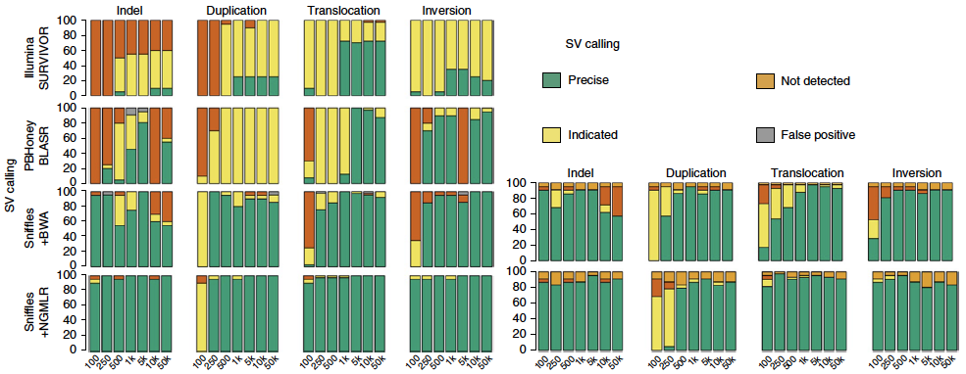
SV Calling
PacBio
Nanopore
Sedlazeck et al., Accurate detection of complex structural variations using single-molecule sequencing. Nat Methods (2018)
11

Slide 12
Build your own reference (assembly)

Slide 13
Annoying fact...
The human reference genome is incomplete
368 unresolved issues, 102 gaps
Segmental duplications, satellites, rDNAs
Modeled centromeres, telomeres, heterochromatin
These gaps contain important information
Missing reference sequence leads to analysis artifacts
Variation in these gaps is unexplored (e.g. rDNAs)
We don’t know what we don’t know…
13

Slide 14
What’s the problem?
Repeats are long, reads are short
“If the overlap is of sufficient length to distinguish it from being a repeat in the sequence the two sequences must be contiguous.”
— Rodger Staden, 1979
repeat
repeat
repeat
repeat
repeat
14

Slide 15
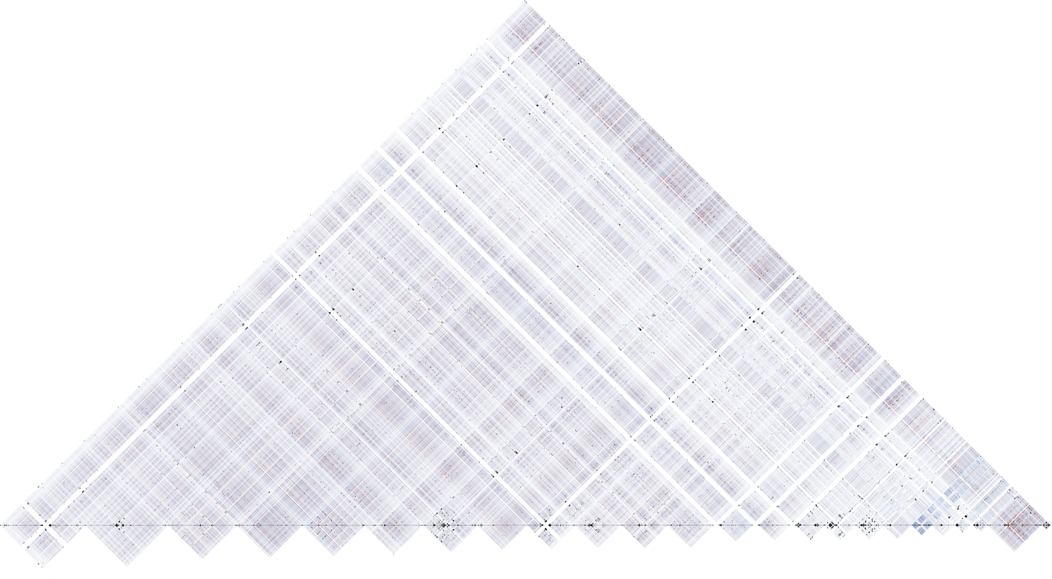
How long do reads need to be, for human?
How long are the repeats?
7 kbp LINEs
1 Mbp+ rDNA arrays
1 Mbp+ centromere arrays
10 Mbp+ heterochromatin blocks
Coverage and accuracy matter too
1,000X of 100 bp reads at 100% accuracy? NO
10X of 10,000,000 bp reads at 100% accuracy, YES
100X of 100,000 bp reads at 90% accuracy, MAYBE?
>50% of the genome
15

Slide 16
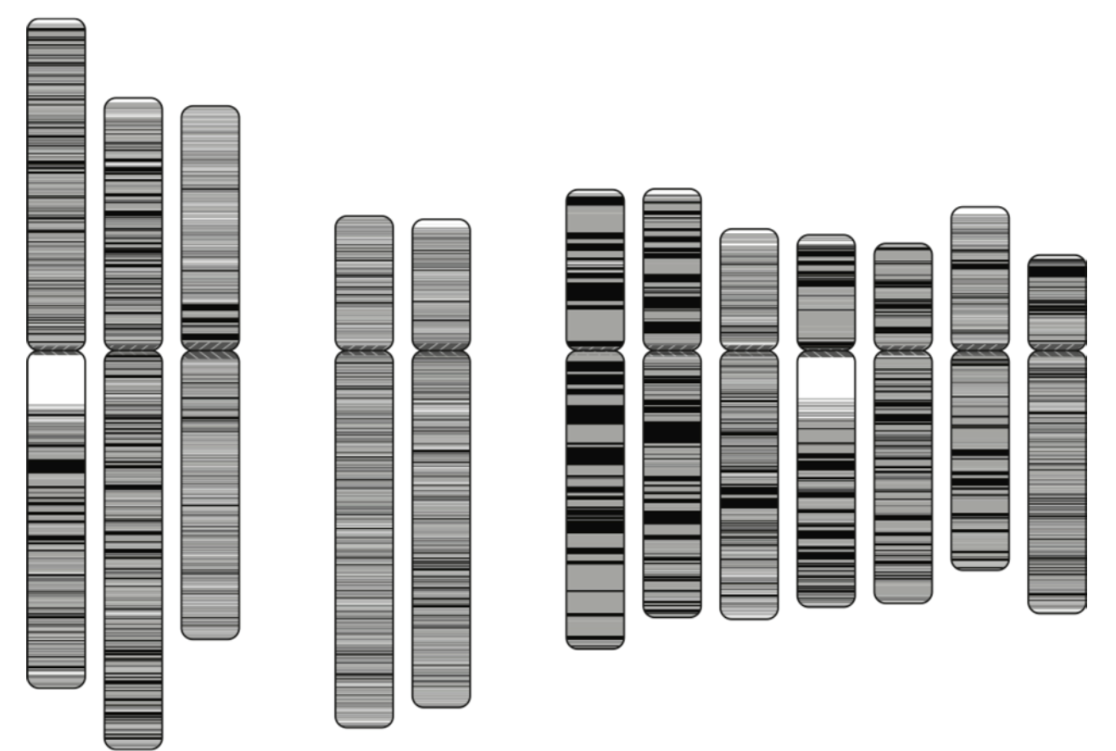

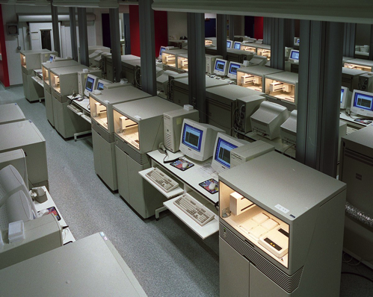
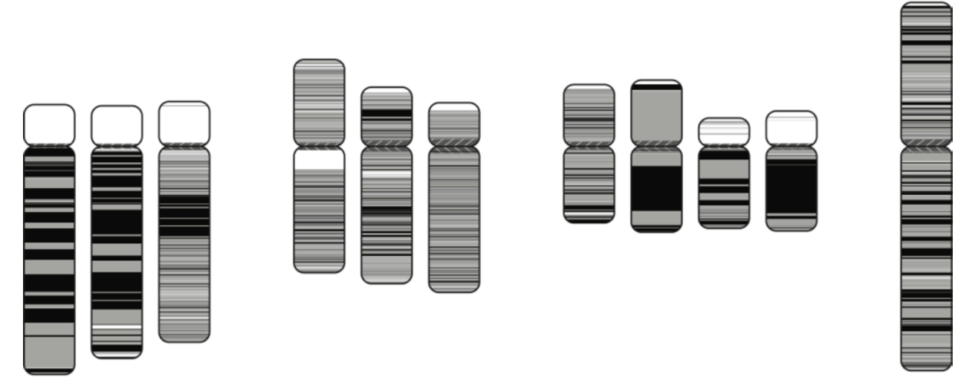
The human genome, 2001
10 years, $3 billion
ref28 NG50 contig 0.5 Mbp
16

Slide 17
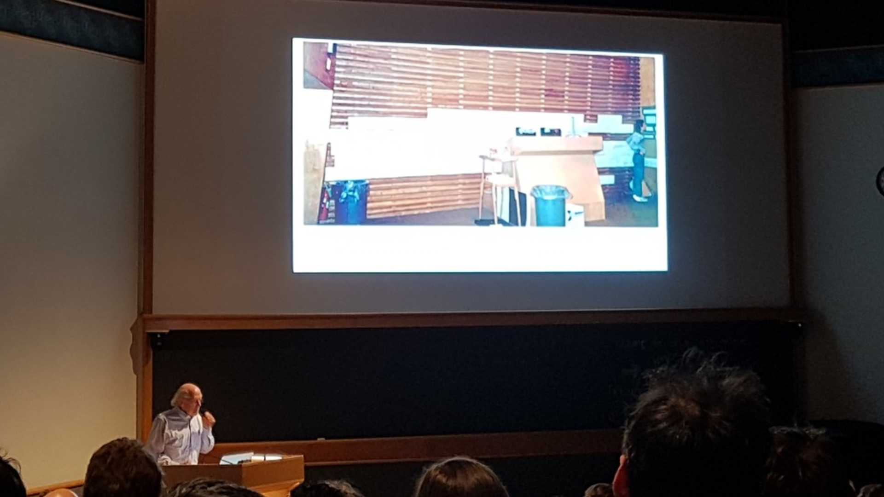

Robert (Bob) Waterson, UW
Biology of Genomes 2019, CSHL
17

Slide 18

The human genome, 2017
GRCh38
1 2 3 4 5 6 7 8 9 10 11 12
13 14 15 16 17 18 19 20 21 22 X
GRCh38 NG50 contig 56.4 Mbp
18

Slide 19

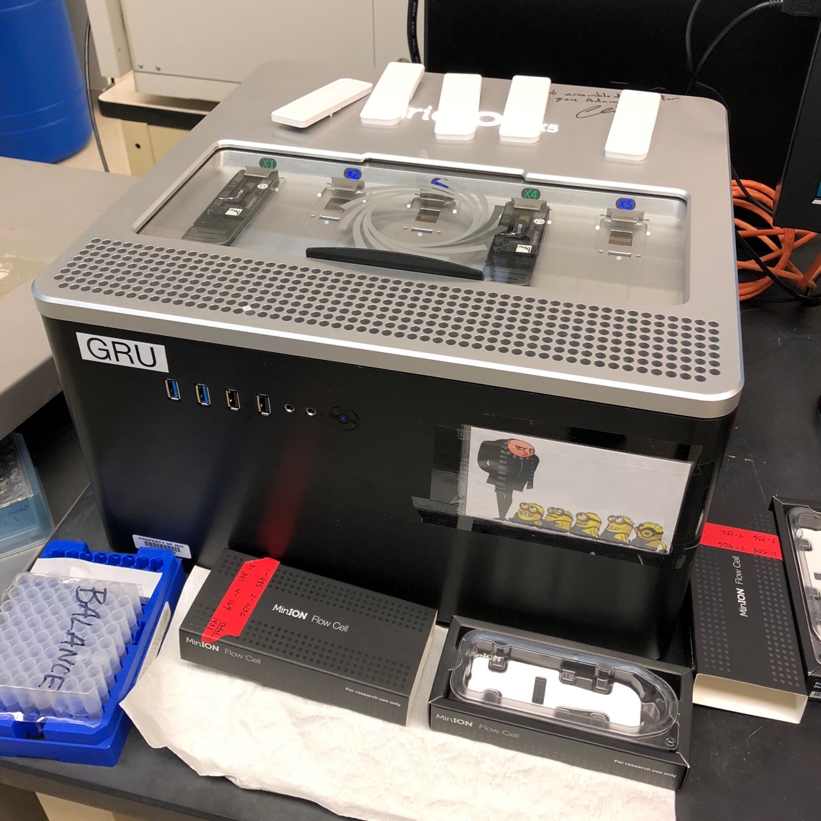
The human genome, 2019
<1 year, < $1 million
Canu
1 2 3 4 5 6 7 8 9 10 11 12
13 14 15 16 17 18 19 20 21 22 X
CHM13 NG50 contig 75 Mbp (70x PacBio + 35x UL ONT)
19

Slide 20
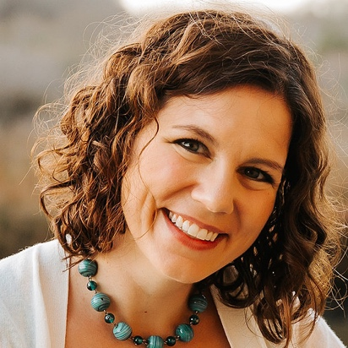
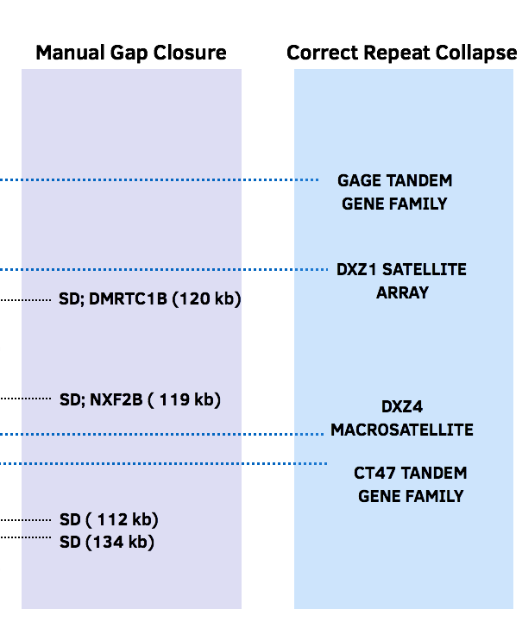
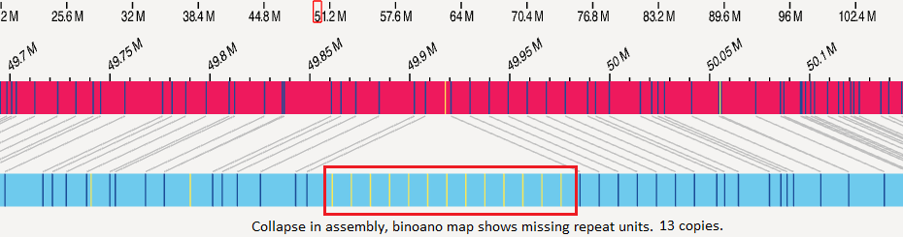
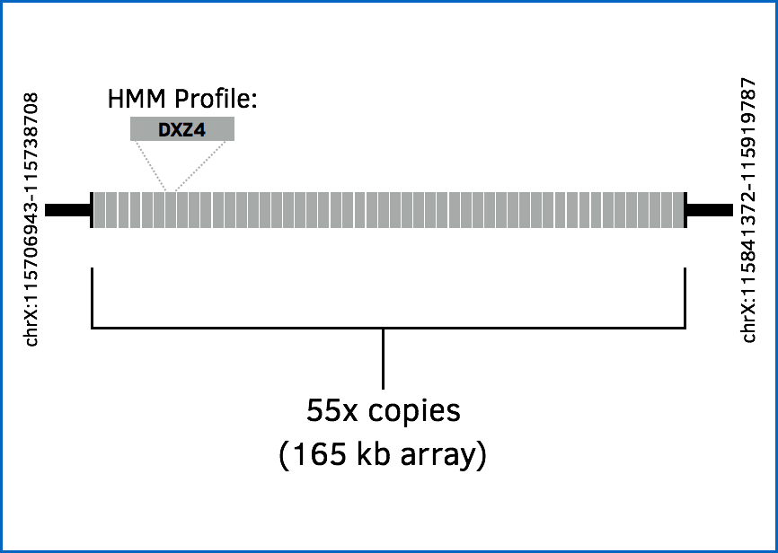
A complete X chromosome
ddPCR
20

Slide 21
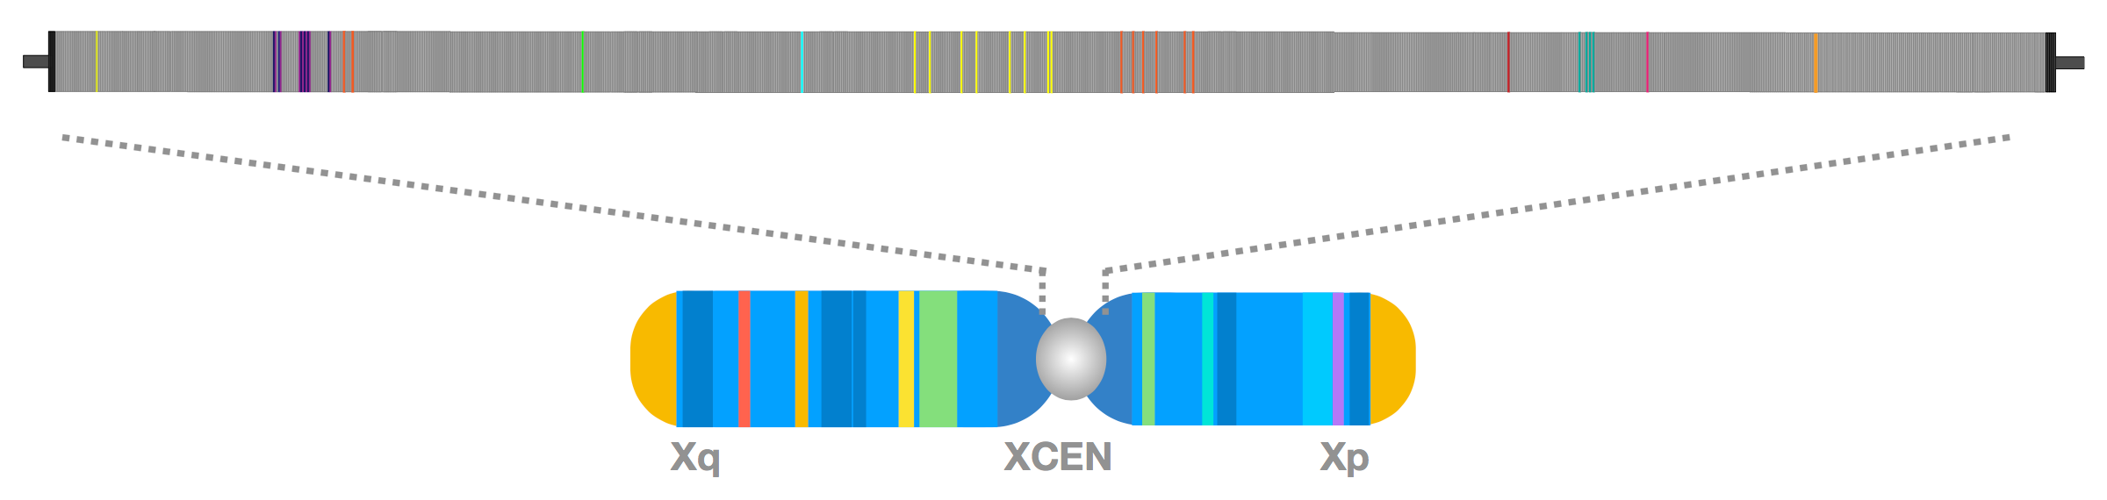
Stitching across the X centromere
Unique structural variants from PacBio
Unique k-mers confirmed by Duplex-Seq
21

Slide 22
Can you map through the centromere?
“Multiple matches”
Unique variations are too sparse
Identity based mapping is unable to distinguish mismatches from unique variants and noise
Centromeres, macrosatellite arrays, segmental duplications, ...
Correct read alignment needed for polishing

Slide 23
Unique marker based anchoring
Mappers prefer the “best” alignment
Consensus can be of variable quality (patches)
Best mapping not always the correct mapping
Marker-based anchoring
Increase number of secondary alignments returned
Redefine mapping quality to measure single-copy k-mer agreement between read and assembly
Before:
After:
”Mapping impossible: aligning long reads through centromeres and satellite arrays” Poster will be presented on Aug. 6-8, NHGRI Summer Student’s Poster Day by Claudia Chu
23

Slide 24
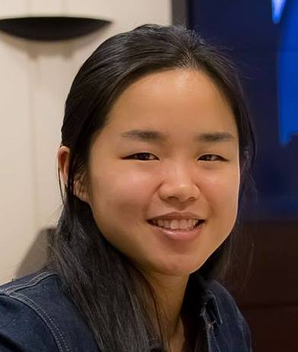
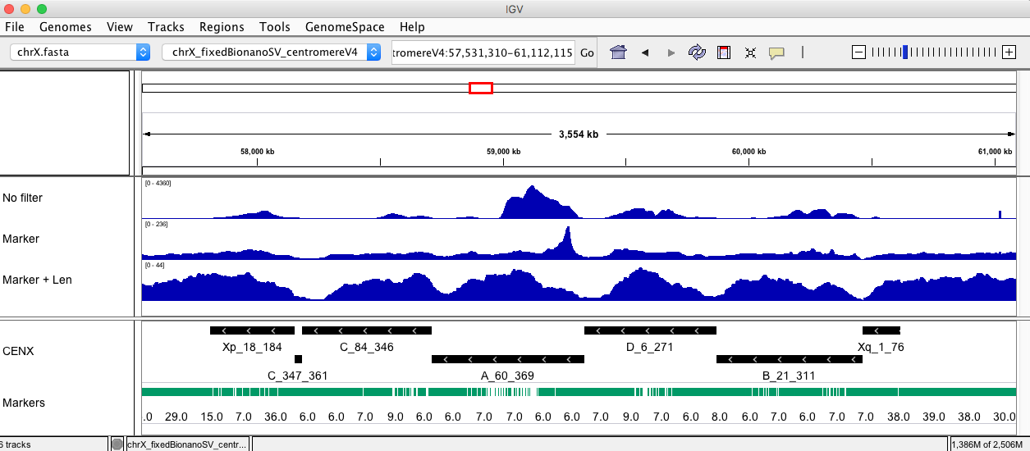
Read depth coverage across CENX
4,360x
236x
43x
”Mapping impossible: aligning long reads through centromeres and satellite arrays” Poster will be presented on Aug. 6-8, NHGRI Summer Student’s Poster Day by Claudia Chu

Slide 25
The genomes assembly problem

Slide 26
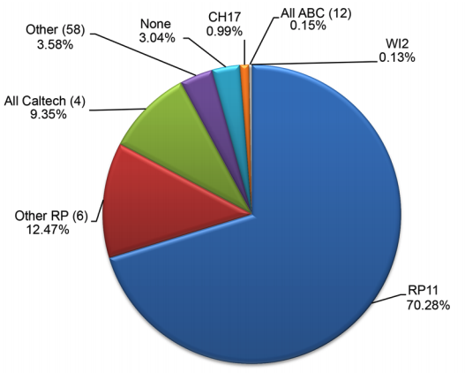
Another annoying fact
The human reference genome is incomplete
368 unresolved issues, 102 gaps
Segmental duplications, satellites, rDNAs
Centromeres, telomeres, heterochromatin
Reference of a single clone
Primary biased towards 1 clone (70%)
African-European male
Not enough alternatives
Schneider et al., Evaluation of GRCh38 and de novo haploid genome assemblies demonstrates the enduring quality of the reference assembly, Genome Research (2017)

Slide 27
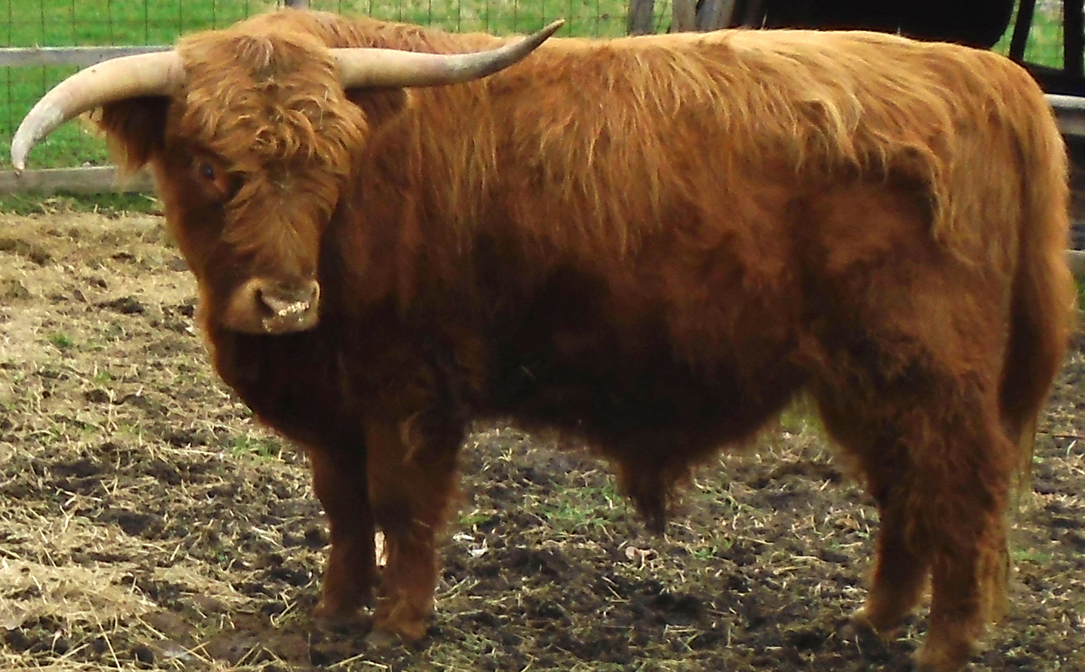
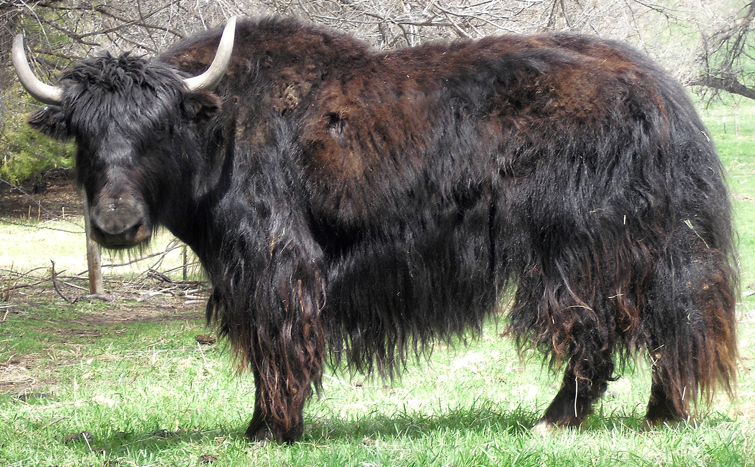
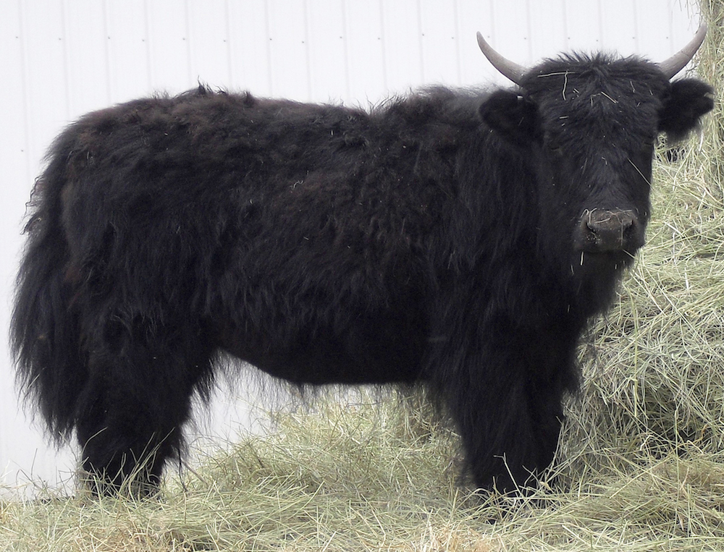
Every genome has its own story
Duke (Sire)
Highland
Molly (Dam)
Yak
Long hair to survive winter
High butterfat milk
Meat is lower in cholesterol
“Best tasting, most tender red meat”
Adapted to high altitudes
Larger lungs and hearts
Fetal hemoglobin (HbF)
Loss of sweat glands
Esperanza
Highlandyak

Slide 28



Trio binning with TrioCanu
Sire
Dam
×
F1 cross
Unassigned
Sire assembly
Dam assembly
Sire haplotype
Parental k-mers
Dam haplotype
Koren and Rhie et al, De novo assembly of haplotype-resolved genomes with trio binning, Nat. Biotech (2018)
28

Slide 29
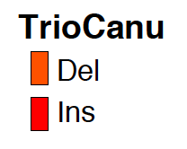
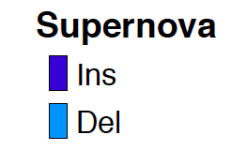
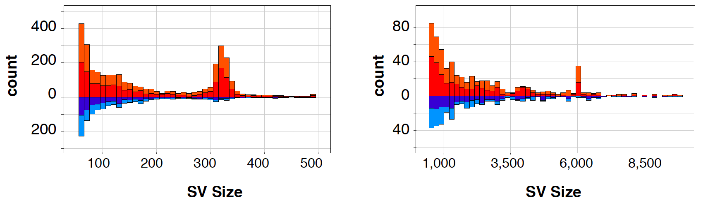
What can you see from two haplotypes?
 | NA12878 (CEU) F
Platform | PacBio (WashU)
Haplotype (Cov.) | Maternal (32+9x) | Paternal (31+9x)
NG50 (Mb) | 1.2 | 1.2
Alu
Line
Koren and Rhie et al, De novo assembly of haplotype-resolved genomes with trio binning, Nat. Biotech (2018)
29

Slide 30
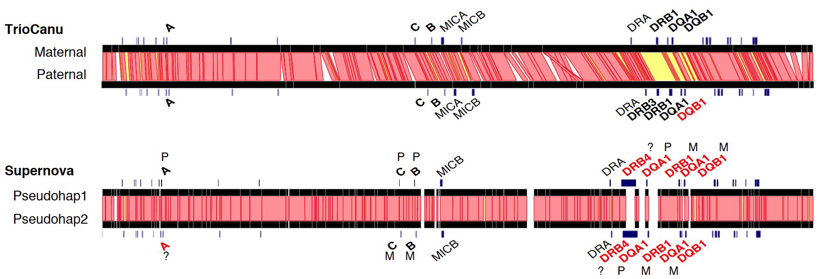
Phasing the MHC region
Koren and Rhie et al, De novo assembly of haplotype-resolved genomes with trio binning, Nat. Biotech (2018)
30
Notes:
Black are typed genes, correct call for both haplotypes, all in phase. 1 indel in the DQB1. Confirms expected missing DRB3 in mother, presence in father but also shows there is other sequence there not a simple deletion

Slide 31
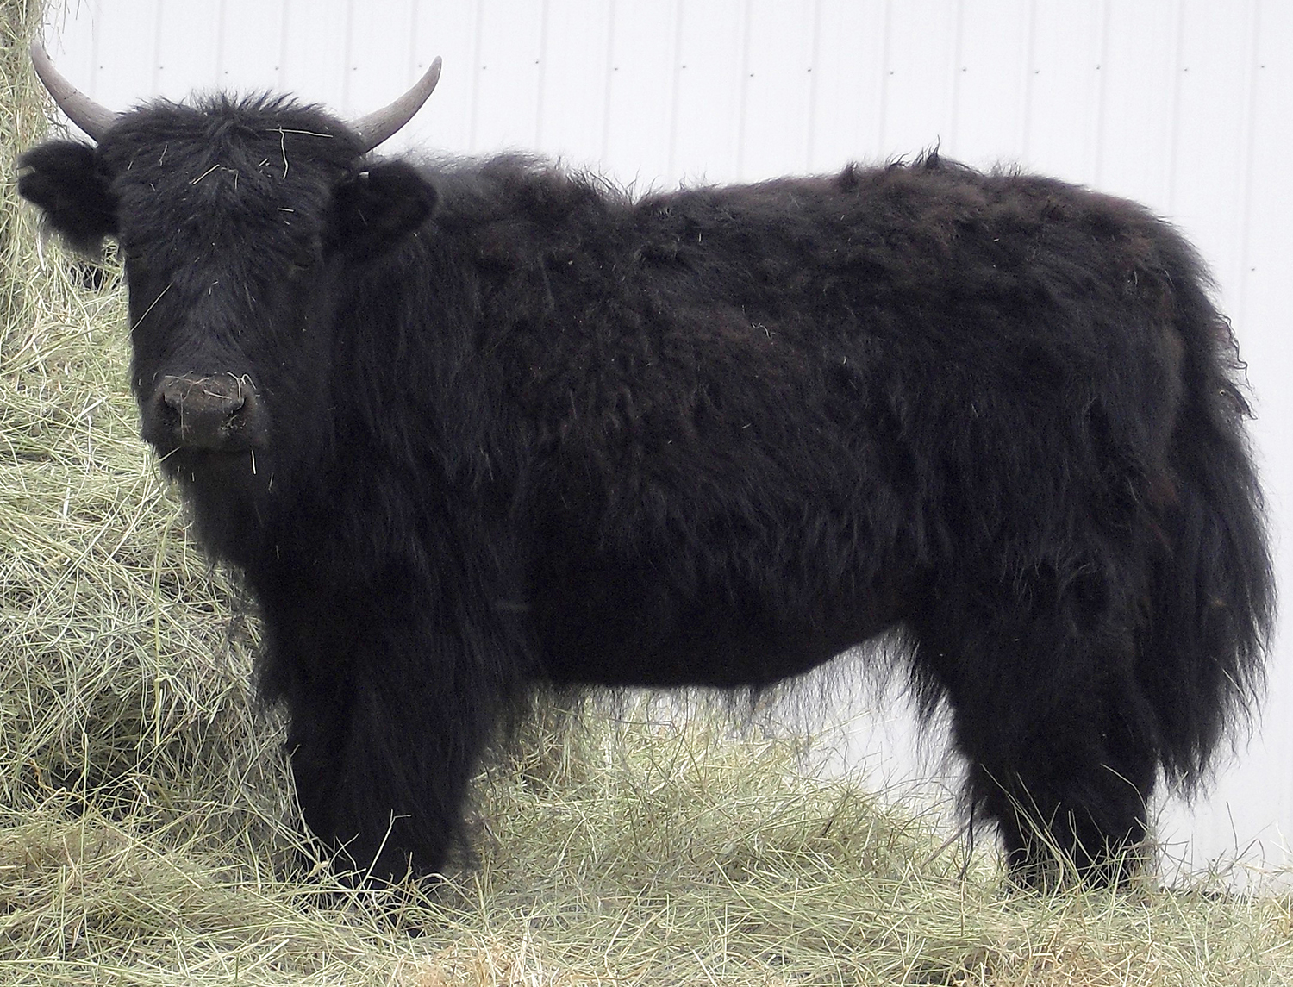
Esperanza: A nearly perfect diploid
Sire (Highland)
Esperanza
Dam (yak)
125x PacBio coverage (~60x per haplotype), no Illumina polishing needed, TrioCanu haplotig NG50 70 Mbp, BUSCOs 94%
31

Slide 32
The human pan-genome project

Slide 33
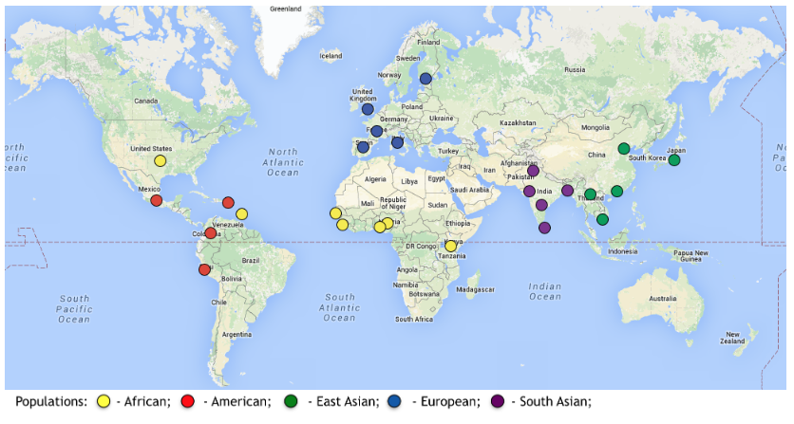
Collect diverse, high-quality haplotypes
Illumina WGS for the parents
PacBio / Nanopore / Bionano / 10X / Hi-C for the child
Pilot 10 trios selected to maximize non-ref haplotype AF
**No European**
Rank | Offspring | Gender | Population Description
1 | HG01109 | M | Puerto Rican in Puerto Rico (PUR)
2 | HG01243 | M | Puerto Rican in Puerto Rico (PUR)
3 | HG02080 | F | Kinh Vietnamese (KHV)
4 | HG03098 | F | Mende in Sierra Leone (MSL)
5 | HG02055 | M | African Caribbean in Barbados (ACB)
6 | HG03492 | M | Punjabi in Lahore, Pakistan (PJL)
7 | HG02723 | F | The Gambia – Mandinka (GWD)
8 | HG02109 | F | African Caribbean in Barbados (ACB)
9 | HG01442 | M | Colombian in Medellin, Colombia (CLM)
10 | HG02145 | M | African Caribbean in Barbados (ACB)
1 PJL
2 PUR
3 ACB
1 KHV
1 CLM
1 GWD
1 MSL
Samples and population description collected from 1000 Genomes Project : http://www.internationalgenome.org/
Notes:
ref allele = #1
weight by non-ref allele’s global AF

Slide 34
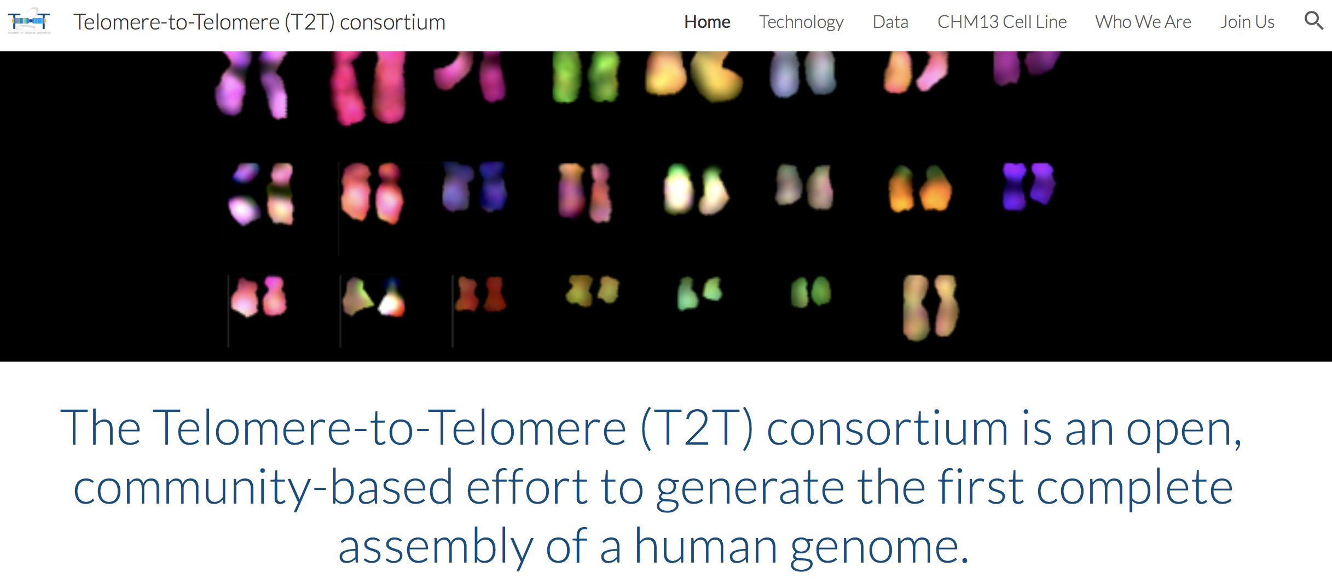
All CHM13, HPGP data is openly released
github.com/nanopore-wgs-consortium/chm13
Draft whole-genome assemblies
Nanopore ultra-long reads
10x Genomics reads
BioNano DLS (WashU)
PacBio (SRA)
Coming soon:
Arima Genomics Hi-C
PacBio CCS
Strand-Seq
github.com/human-pangenomics/hpgp-data
34

Slide 35

VertebrateGenomesProject.org

Slide 36

Vertebrate Genomes Project
HQ Reference assemblies
>1 Mb contig N50
Scaffolds == chromosomes
99.99% average base quality
Sequencing Technology
Long reads: PacBio
Linked reads: 10x Genomics
Optical maps: BioNano
Cross linking: Arima Hi-C
~250
~1,000
~10,000 G10K
~60,000 B10K, Bat1K
Orders
Families
Genera
Species
Erich Jarvis, chairperson – worldwide consortium of universities, museums, zoos, etc.
36

Slide 37
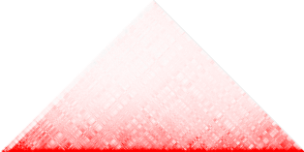
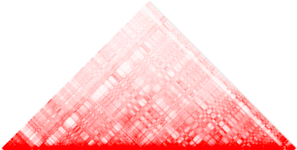
VGP Assembly Pipeline
PacBio
Contigging
+ Purging
A
TGGGGA
Gap-filling &
A
TGGGGA
A
TGGGGA
Polishing
C
TGGA
10XG
Scaffolding
A
TGGGGA
BioNano
exon 1
exon 2
exon 3
Scaffolding
Curation
Hi-C
Final assembly
Scaffolding
Primary
Alternate
Pipeline available on https://github.com/VGP/vgp-assembly/pipeline, optimized to run on biowulf
37

Slide 38
Summary
Mapping with long reads
Better for SV detection
NGMLR, minimap2
Reads are getting longer
Good time for planning genome assemblies
Nanopore ultra long reads for assembling T2T
PacBio reads for polishing
TrioCanu to get completely phased haplotypes

Slide 39
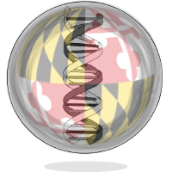


Acknowledgements
genomeinformatics.github.io
Adam Phillippy
Sergey Koren
Brian Walenz
Claudia Chu
Chirag Jain
Brian Ondov
Alexander Dilthey
Jay Ghurye
HPGP
NIH NHGRI NISC
Karen Miga
Benedict Paten
Pacific Biosciences
Oxford Nanopore
10X Genomics
Bionano Genomics
Arima Genomics
Cattle trio
Tim Smith
John Williams
Assembly Working Group
Erich Jarvis
Richard Durbin
Gene Myers
Kerstin Howe
Olivier Fedrigo
Francoise Thibaud-Nissen
Will Chow
Trio binning is available in https://github.com/marbl/canu

